Slide 1
MBSD LAB Introduction to 8051 Microcontroller & Installation of software and hardware tools
Engr. Shahzada Fahim Jan

Slide 2

No Cell Phones During Lecture

Slide 3
Quiz No: 1
Write Your Name, Reg No and Section
Bin | Dec | Hex
 |  | 0xAA
 |  | 0x55
 | 10
 | 16
1111 0000

Slide 4
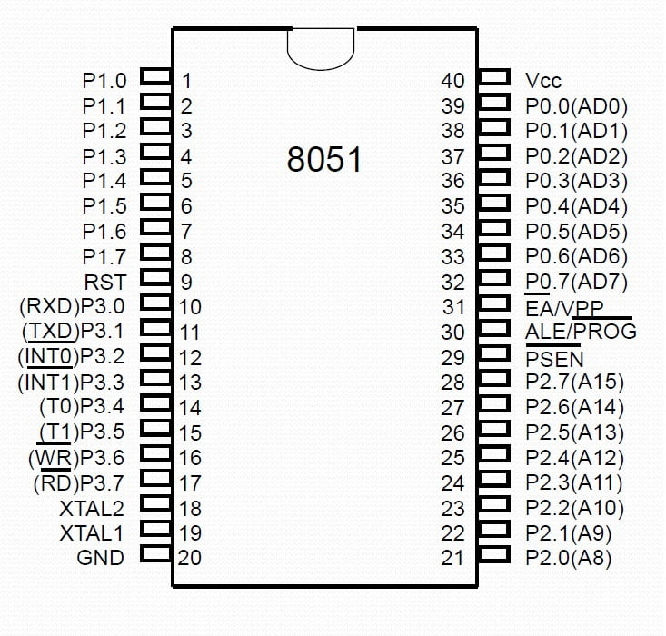
8051 Microcontroller

Slide 5
8051 Microcontroller
The microcontroller like 8051 was designed in the year 1981 by Intel
The microcontroller is one kind of integrated circuit that includes 40-pins with dual inline package or DIP
RAM-128 bytes, ROM-4kb & 16-bit timers–2.
4 – parallel 8-bit ports
The microcontroller comprises of 8-bit accumulator & an 8-bit processing unit.
It also consists of 8 bit B register
I/O Pins – 32 which are arranged like four ports such as P0, P1, P2 & P3.

Slide 6
8051 Microcontroller
It is an 8 bit microcontroller
8051 can work on 8 bit of data at a time
Data larger then 8 bit has to be broken into 8-bit pieces to be processed by the CPU.
Four I/O ports each 8-bit wide

Slide 7
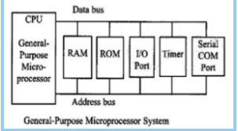
Microcontroller and Microprocessor.
Microprocess contains no ROM, no RAM, and no I/O Ports on the chip itself.
Commonly reffered to as general-purpose microprocessors
We can add external memory, I/O or timer to it

Slide 8
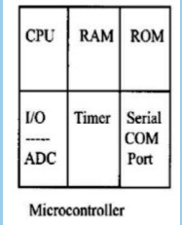
Microcontroller and Microprocessor.
On chip RAM, ROM, I/O ports and timer
Cannot add external memory, I/O or timer.
Ideal for many applications in which costs
And space are critical.
Less power consumption

Slide 9
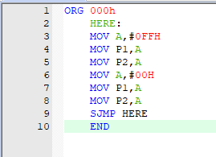
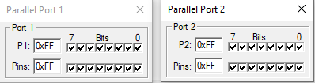
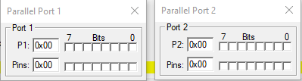
Assembly Language for 8051

Slide 10
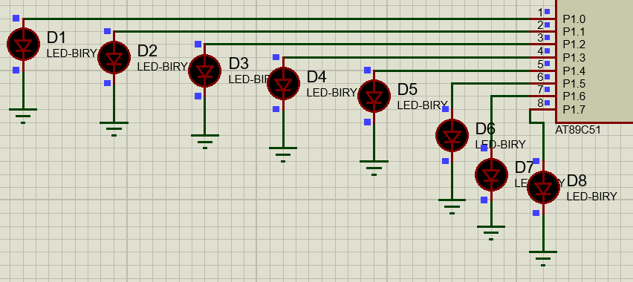
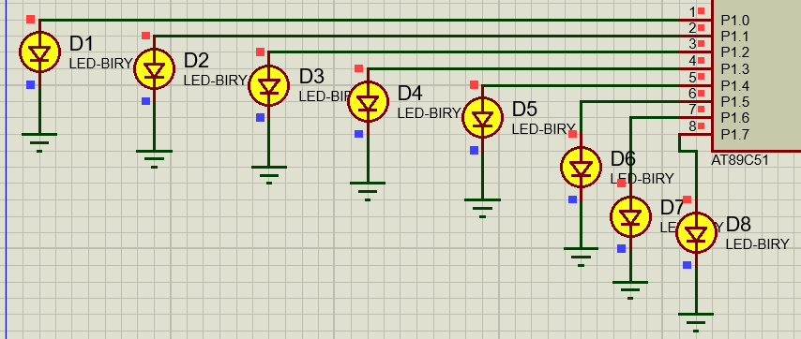

Slide 11
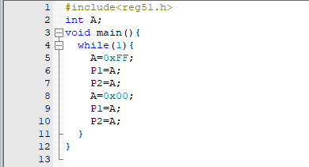
C Language for 8051

Slide 12
Lab Task
Write assembly and C language code to toggle the led attached with P1 and P2 continuously

